Slide 1
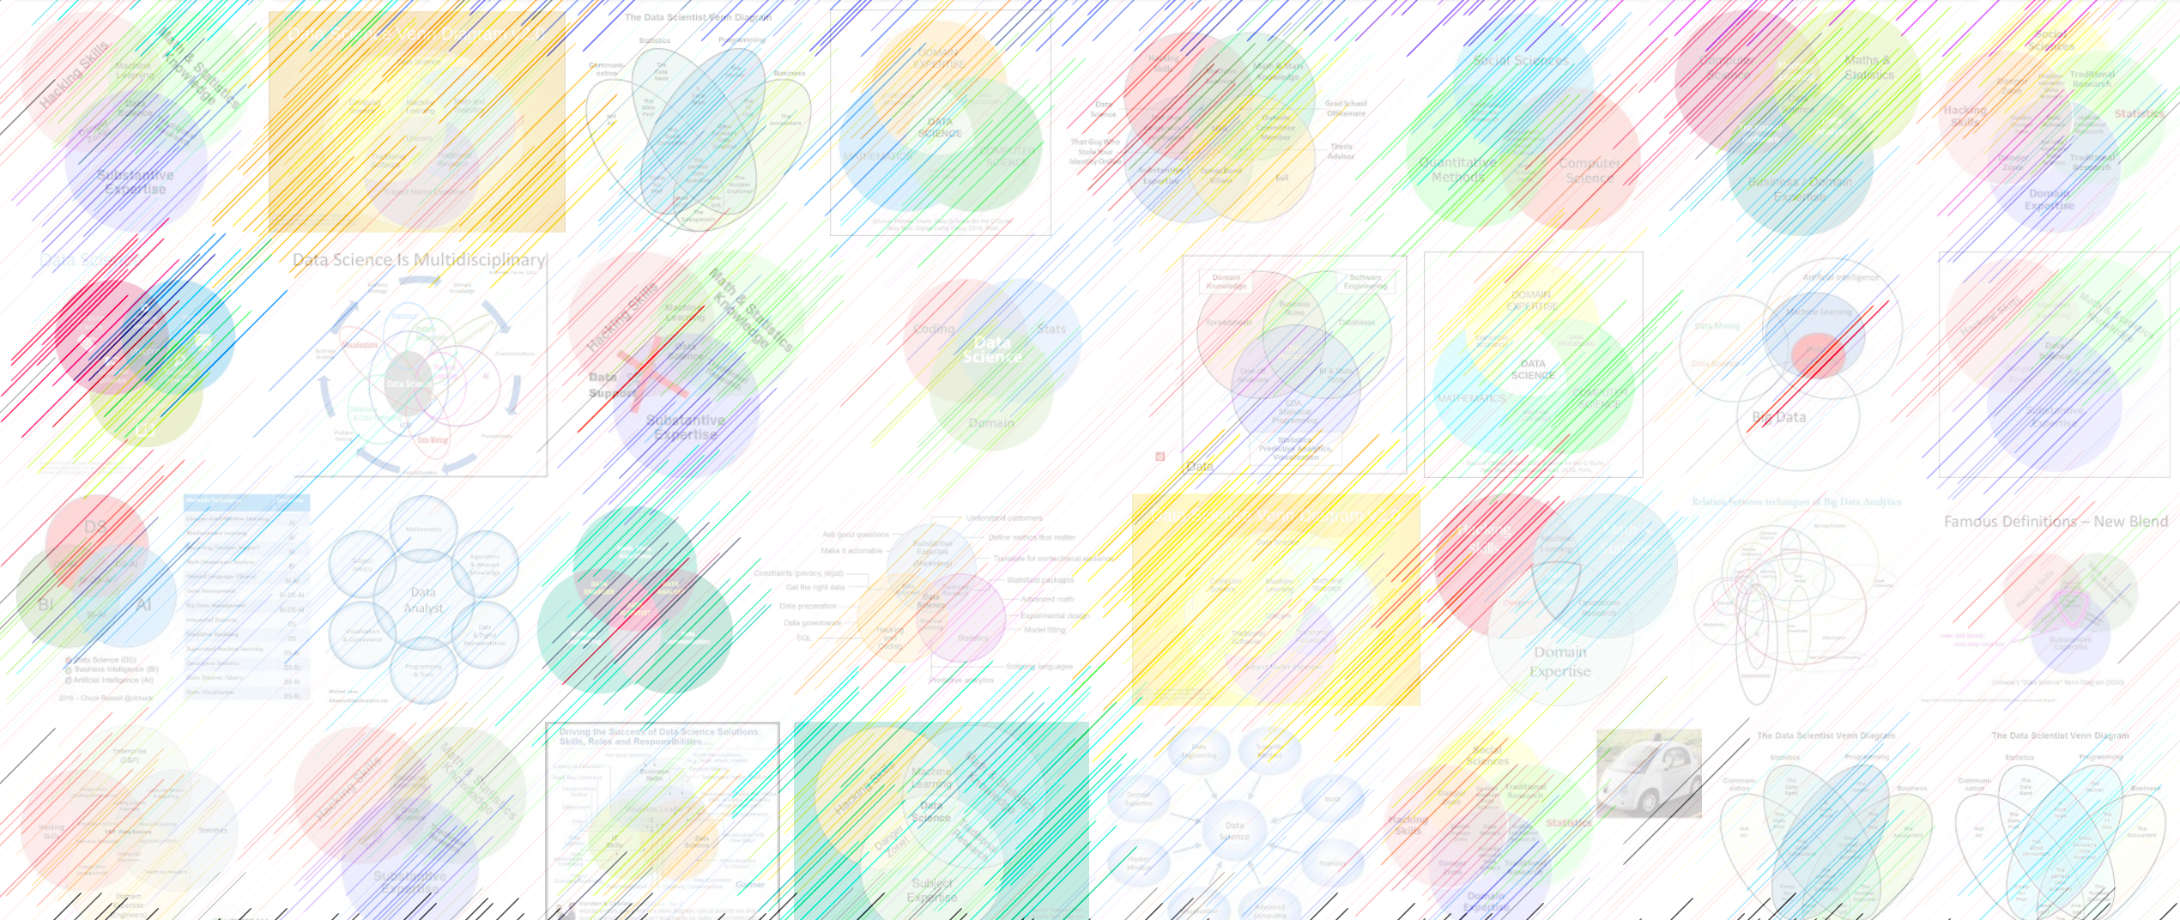

Intro Machine Learning 01 Overview
William Trimble
Spring 2023

Slide 2
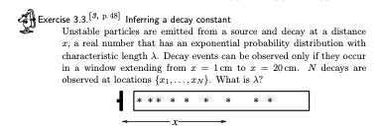
Administrivia
Week 1: read chapters 2 and 3 of Information Theory, Inference, and Learning Algorithms.
Today: whirlwind overview
Thursday: Bayesian estimation of continuous parameters
Homework 1, heavy on
prerequisites (calculus,
linear algebra, some
programming) is posted.

Slide 3
Administrivia
Grading: 70% homework, 30% group project
Lowest homework dropped, no questions asked.
Group project: ~7th week. Open-ended; choose a dataset and find something interesting if you can.

Slide 4

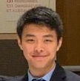

Who are we?
Instructors:
William Trimble wltrimbl@uchicago.edu
TA’s:
Richard Huang <rrhuang@uchicago.edu>
TA2: Melissa Adrian <@uchicago.edu> PhD student in Statistics

Slide 5
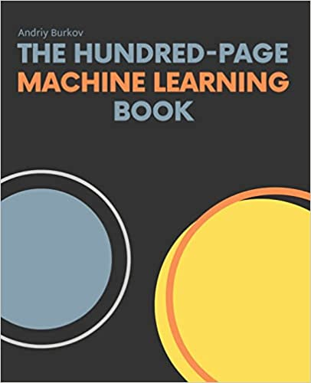
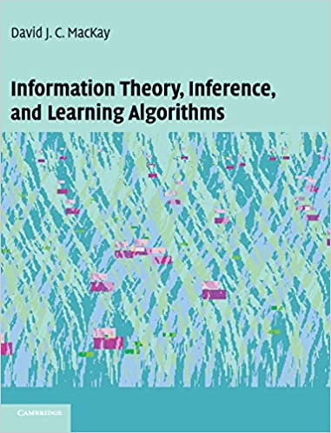
Andriy Burkov David MacKay

Slide 6
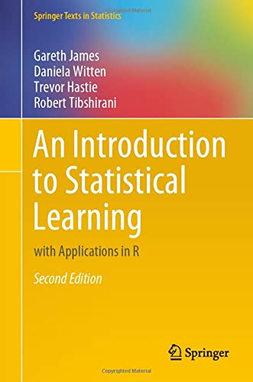
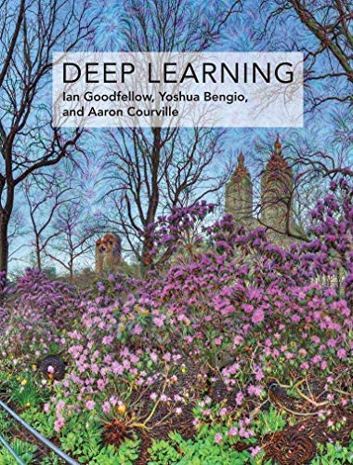
Gareth James Ian Goodfellow

Slide 7
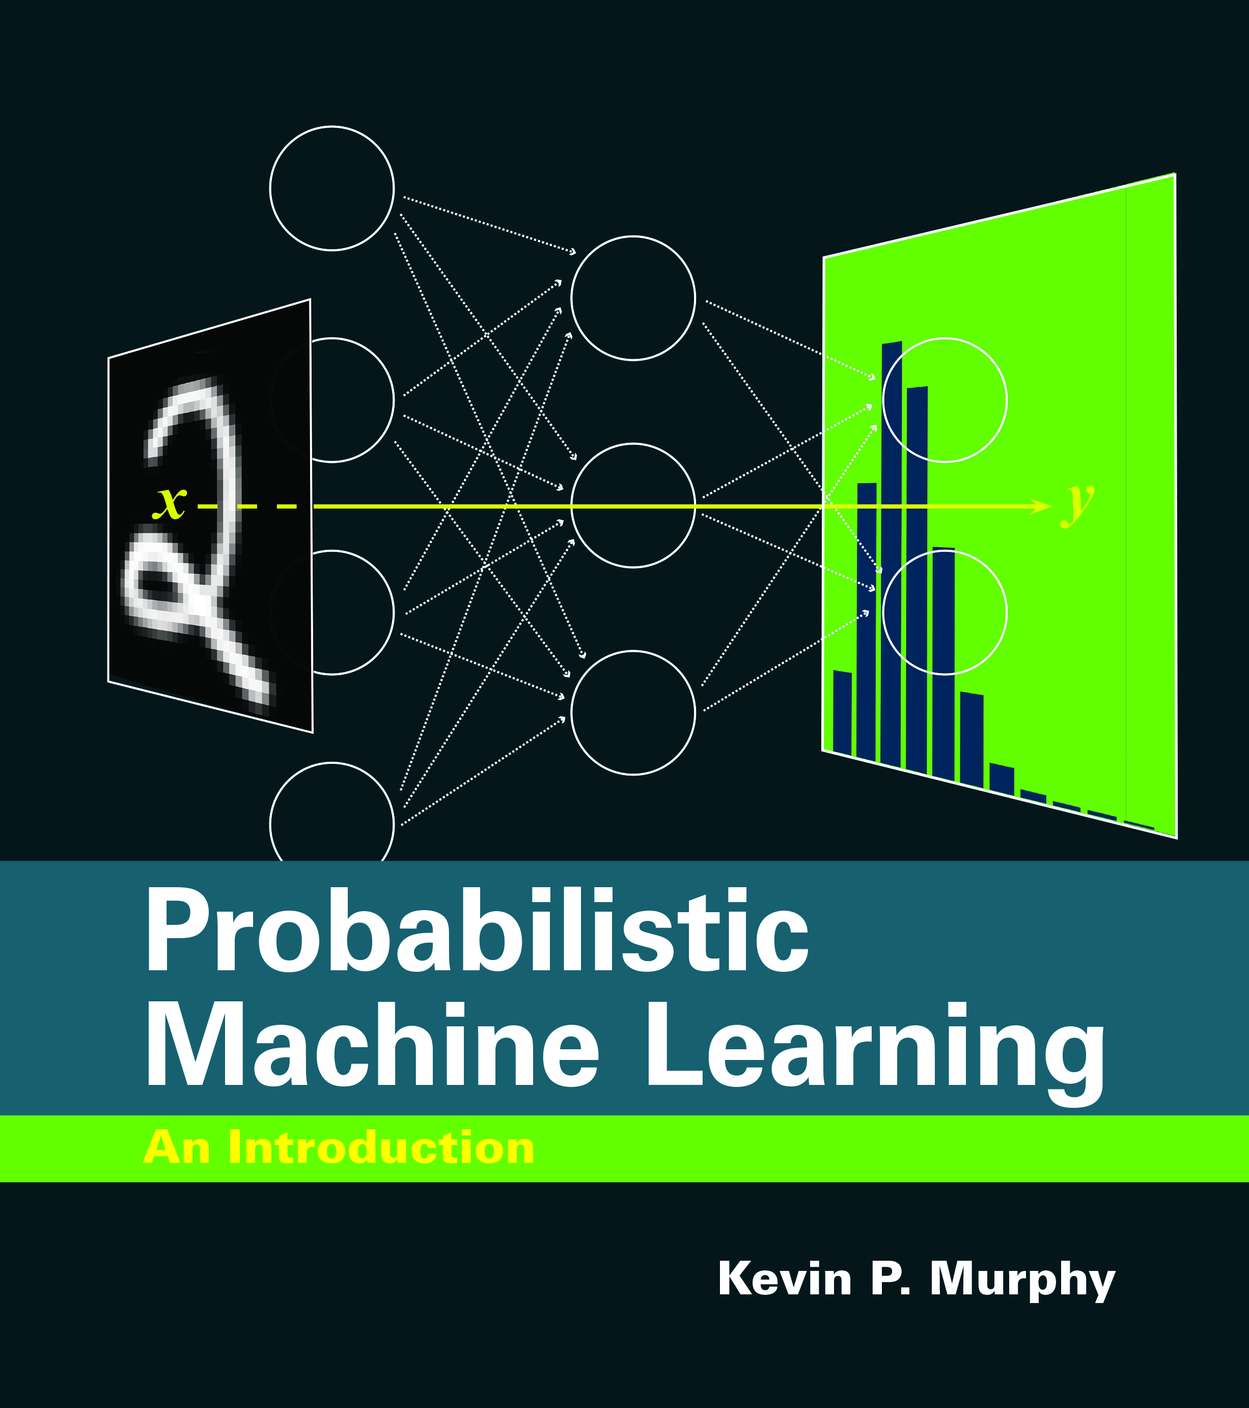
CS profs tend to be generous with their IP…
https://probml.github.io/pml-book/book1.html

Slide 8

Why is this funny?

Slide 9
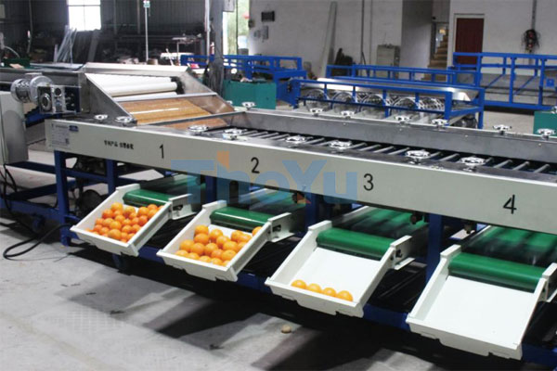
What is Machine Learning?
That part of data analysis concerned with automated decisionmaking
”Modeling” “parameter estimation” are related but narrower
Why data? If the task can be solved without data (say, by applying thresholds) you don’t need ML
This machine does not learn

Slide 10
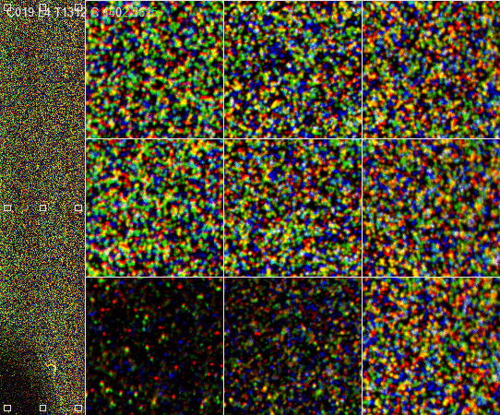
So-called NGS sequencing data: one of the data firehoses

Slide 11
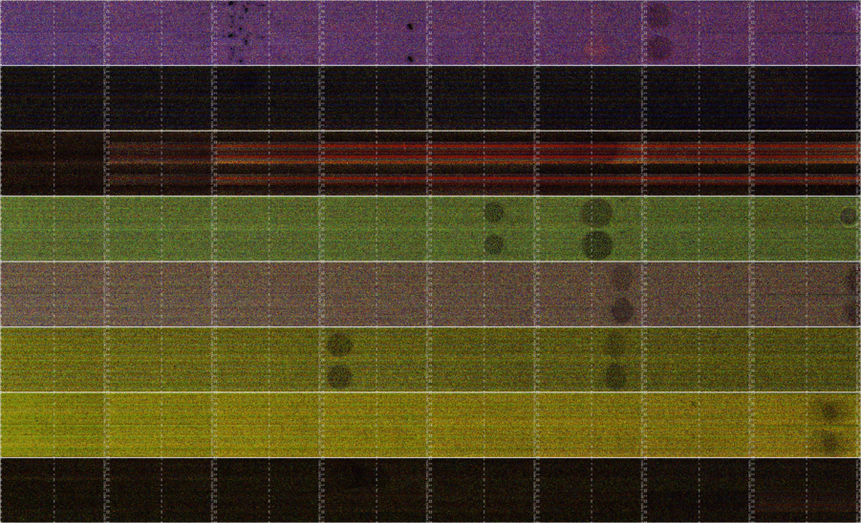

Slide 12
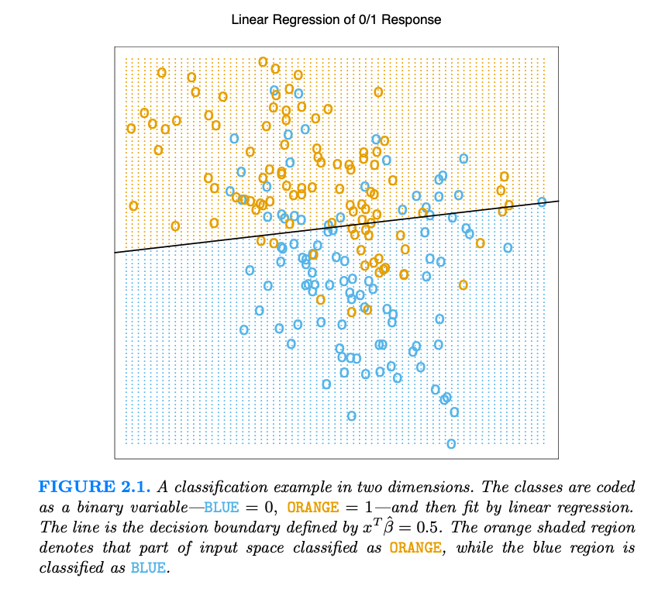
Hastie, ESL, Ch 2

Slide 13
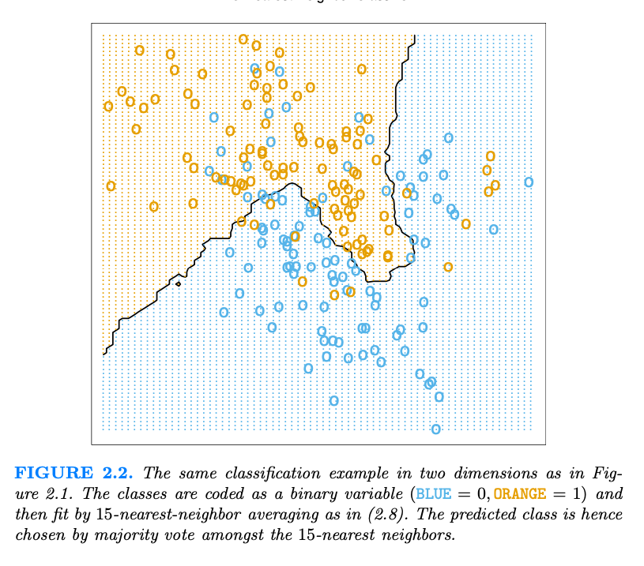
Hastie, ESL, Ch 2

Slide 14
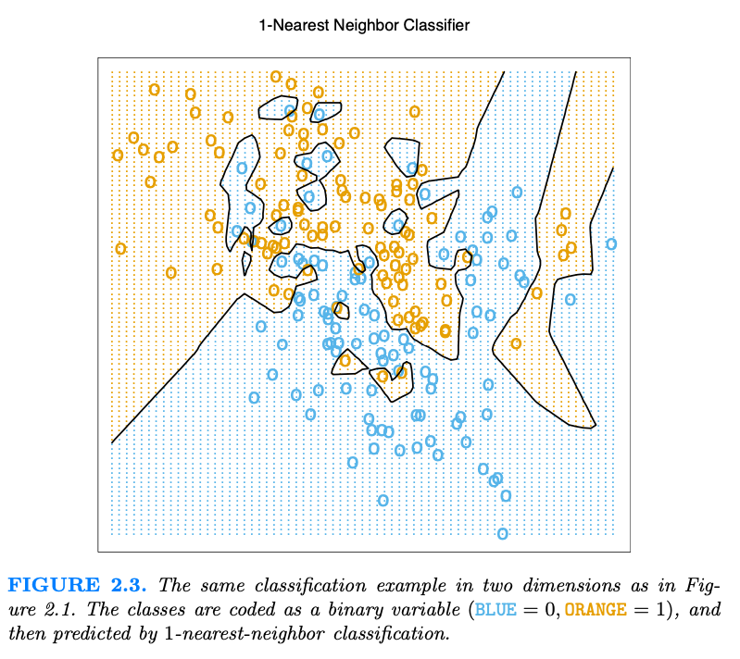
Hastie, ESL, Ch 2

Slide 15
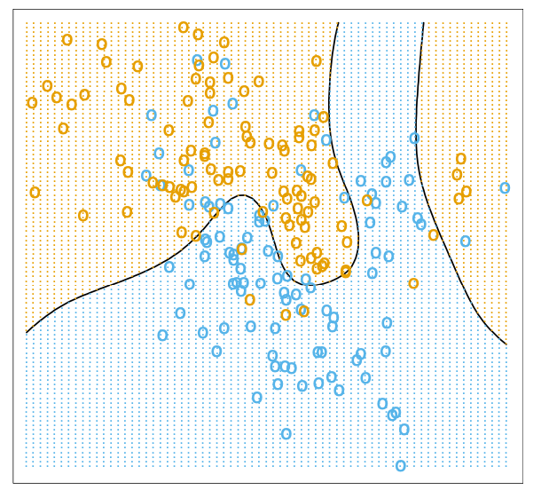
The optimal Bayes decision boundary for the simulation example. Since the generating density is known for each class, this boundary can be calculated exactly.
Hastie, ESL, Ch 2

Slide 16

The steps
Define the Task (input space and output space)
Data preprocessing (feature extraction & wrangling)
Measure performance
Train (or “learn”) the model
Victory ?!?

Slide 17
There are myriad tasks
Regression -- predicting some values of interest
Imputation of missing values
Classification – put data points into categories
Classification with missing inputs
collection of many classifiers, each for different set of missing data items?
generate a probability density for everything, marginalize over missing inputs
Transcription –encode symbols in an image or audio waveform
Structured output – answer very specific questions, like map annotation, write computer programs or captions
Anomaly detection – fraud detection, for instance
Noise detection / removal / error correction
Density estimation; fitting (parameters of interest)
Goodfellow, Ch 5

Slide 18
There are myriad tasks
Regression -- predicting some values of interest
Imputation of missing values
Classification – put data points into categories
Classification with missing inputs
collection of many classifiers, each for different set of missing data items?
generate a probability density for everything, marginalize over missing inputs
Transcription –encode symbols in an image or audio waveform
Structured output – answer very specific questions, like map annotation, write computer programs or captions
Anomaly detection – fraud detection, for instance
Noise detection / removal / error correction
Density estimation; fitting (parameters of interest); matching
Advertising, prediction
Medical diagnosis
Recommender algorithms
Machine translation
generation of textures, waveforms
Fake news; security applications
Geodesy; remote sensing; astronomy
fingerprints, DNA
Goodfellow, Ch 5

Slide 19
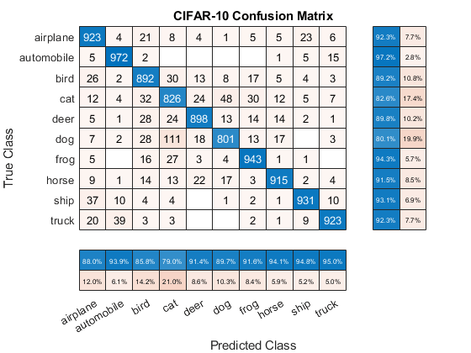
Measure Performance
How well does the model answer our question?
Measure “accuracy”
Maybe fold in costs for different sorts of errors
to guide decision thresholds; manage our training
in light of expected frequencies
Measure accuracy on the training set and on data not used for training “testing” or “holdout” sets.
Calculus helps us for continuous variables / continuous inputs
Brute force or Markov-chain Monte Carlo for discrete variables
Space of parameters is often exceedingly large and complex; we usually have to resort to randomized algorithms and truncated representations.
Goodfellow, Ch 5

Slide 20
Train (or “learn”) the model
Unsupervised algorithms usually try to distill the empirical probability density into something that can be succinctly communicated.
This the essence of compression
Clustering, finding groups of similar items, recommendation
Dimension reduction, embedding, big data visualization
Supervised algorithms: training data with gold-standard labels or desired outcomes
Semi-supervised: we can only afford to label some of the data, but have access to a larger population of unlabeled data for modeling its density
Goodfellow, Ch 5

Slide 21
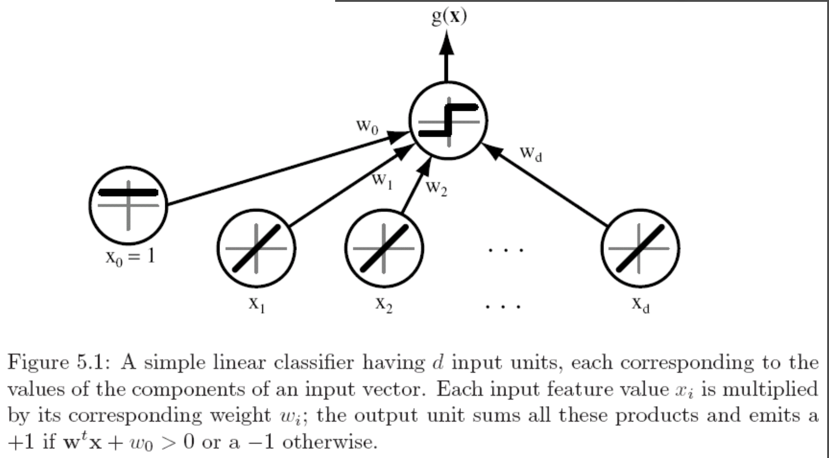
Linear classifier
Duda, Pattern Classification

Slide 22
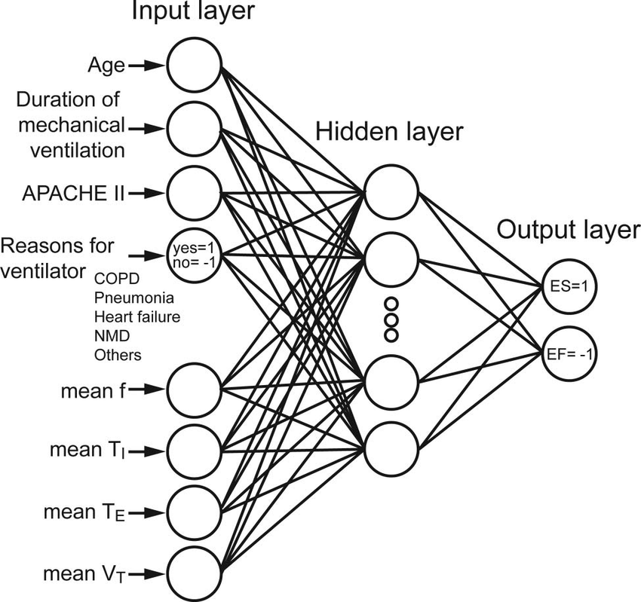
Neural networks
Linear classifiers
+nonlinear sauce
= arbitrary function machines
Kuo et al. doi:10.4187/respcare.03648

Slide 23
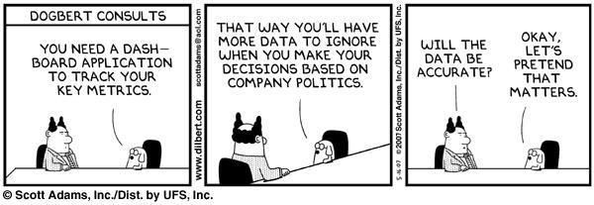

Slide 24
New data
Black box
Predictions/
decisions

Slide 25
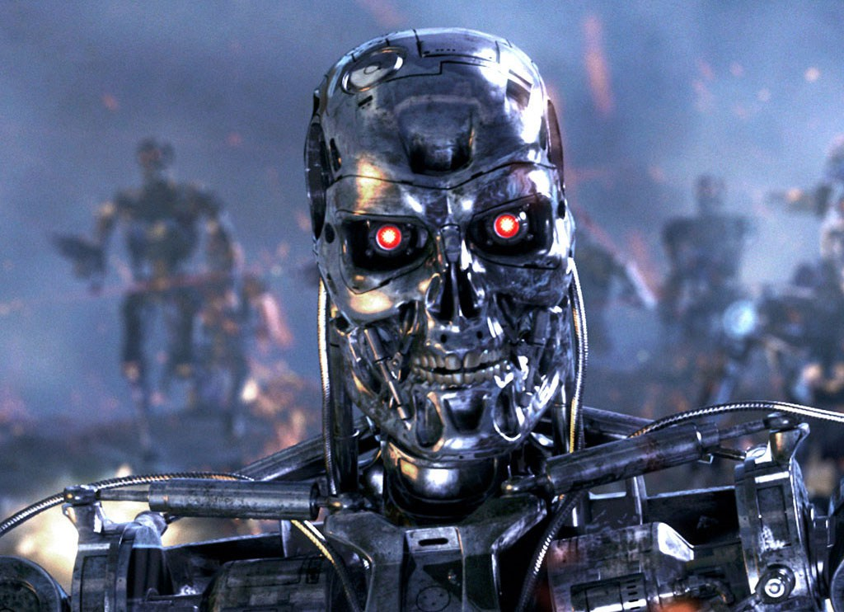
Training data
ML algorithm
New data
Black box
Predictions/
decisions

Slide 26
Unlabeled data
Training data
ML algorithm
New data
Black box
Predictions/
decisions

Slide 27
Training data
ML algorithm
Explanations?
New data
Black box
Predictions/
decisions

Slide 28
Training data
ML algorithm
New data
Black box
Predictions/
decisions

Slide 29
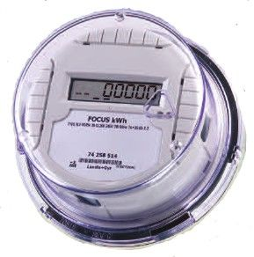
Where do the costs lie?
Training data
ML algorithm
New data
Black box
Predictions/
decisions

Slide 30
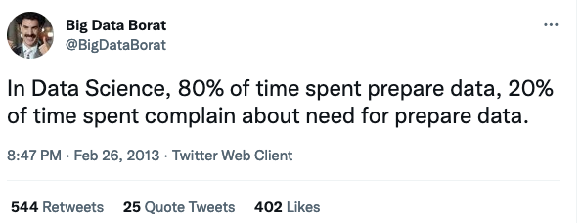
Where do the costs lie?
Most of the cost is in getting (locating, collecting, preparing)
worthwhile, relevant, usable training data.

Slide 31
Unlabeled data
Training data
ML algorithm
Explanations?
New data
Black box
Predictions/
decisions

Slide 32
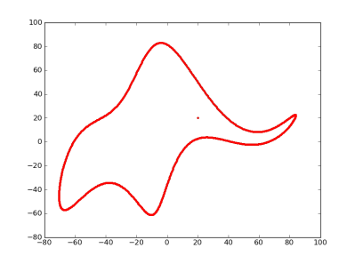
With an ocean of free parameters, we can fit anything.
“with four parameters I can fit an elephant, and with five I can make him wiggle his trunk.”
– John von Neumann, as told to Enrico Fermi, as told by Freeman Dyson.
doi://10.1038/427297a
doi://10.1119/1.3254017

Slide 33
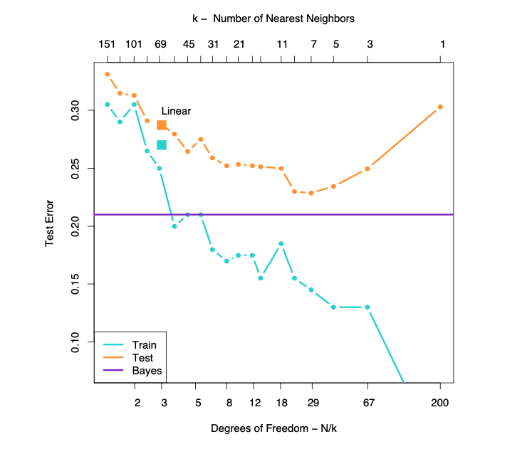
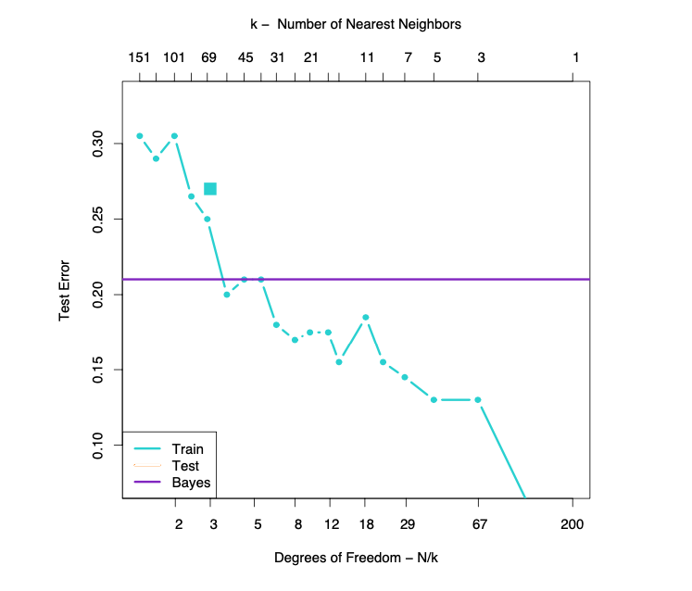
But explaining my data perfectly does not confer utility.
Hastie, ESL, Ch 2
Model complexity

Slide 34
Models that can be perfect on the training data fail miserably on data that the model has not seen.
Hastie, ESL, Ch 2
Model complexity

Slide 35
Generalization error
Underfitting
Overfitting
Generalization error
Model complexity
Hastie, ESL, Ch 2

Slide 36
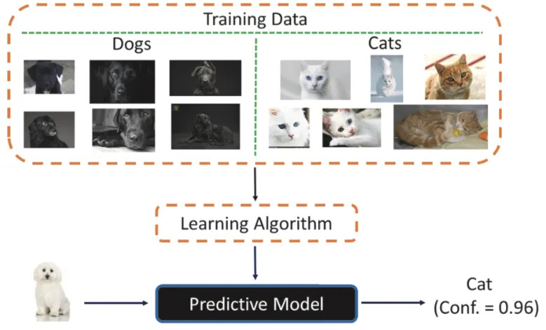

Slide 37
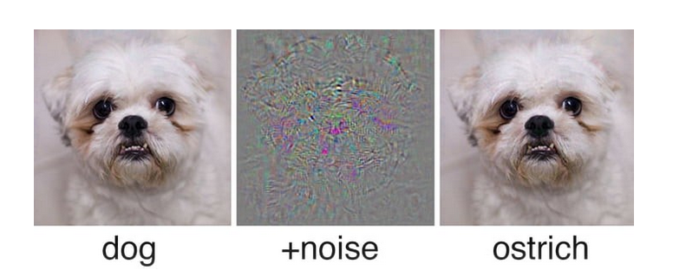
ML systems don’t make mistakes the way that we do…
Maliciously constructed inputs can lead machine-decision makers astray

Slide 38
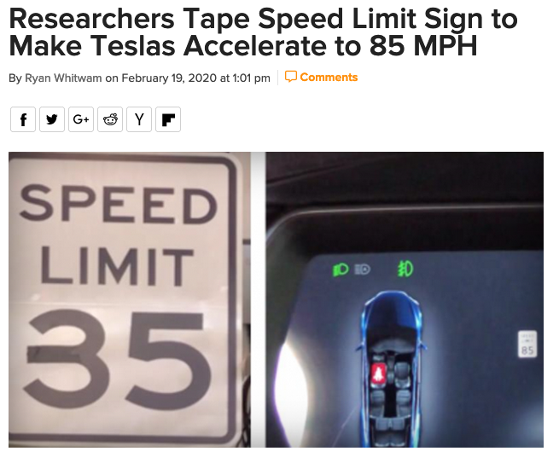
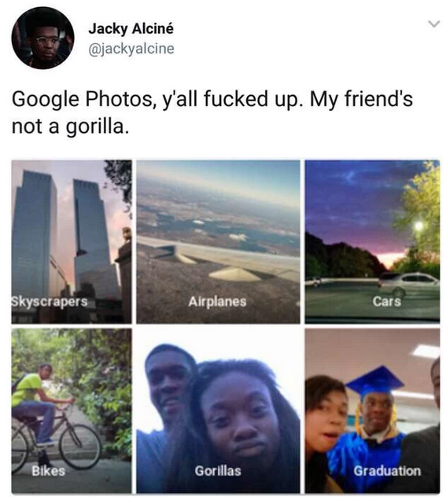

Data, ML systems are tools that benefit some more than others

Slide 39
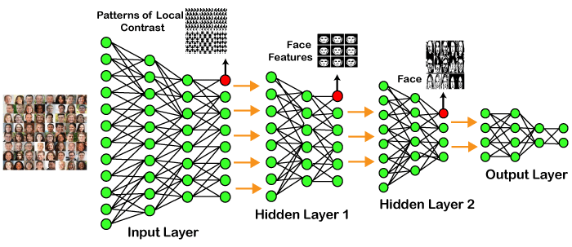
What is good?
What makes a good algorithm / model / procedure?

Slide 40
What is good?
What is a good algorithm / model / procedure?
Accuracy on out-of-bag data?

Slide 41
What is good?
What is a good algorithm / model / procedure?
Accuracy on out-of-bag data?
Desired properties: train / retrain without great expense?
Desired properties: return answers extremely quickly?
Desired properties: generalize to data that perhaps aren’t like the training data ???
Desired properties: get good accuracy with comparatively little training data. !!!

Slide 42
Where do advances come form?
The past 10 years has seen remarkable advances in computational decisionmaking. Where do these come from?
More data + more compute (Moore’s law + AWS)
Better models: models that are well-adapted to the data can get better accuracy for the same amount of training data. (CNN, BERT)
New approaches (Generative Adversarial Networks; reinforcement learning)

Slide 43

The toolbox
The toolbox has different kinds of things.
“Traditional” algorithms that work (E-M, backpropagation, simulated annealing)
Learning procedures sometimes correspond to Bayesian inference. Often can only draw samples via Markov Chain Monte Carlo sampling.
“Nonparametric” methods that look a little like adhockery
Optimization, stochastic gradient descent

Slide 44
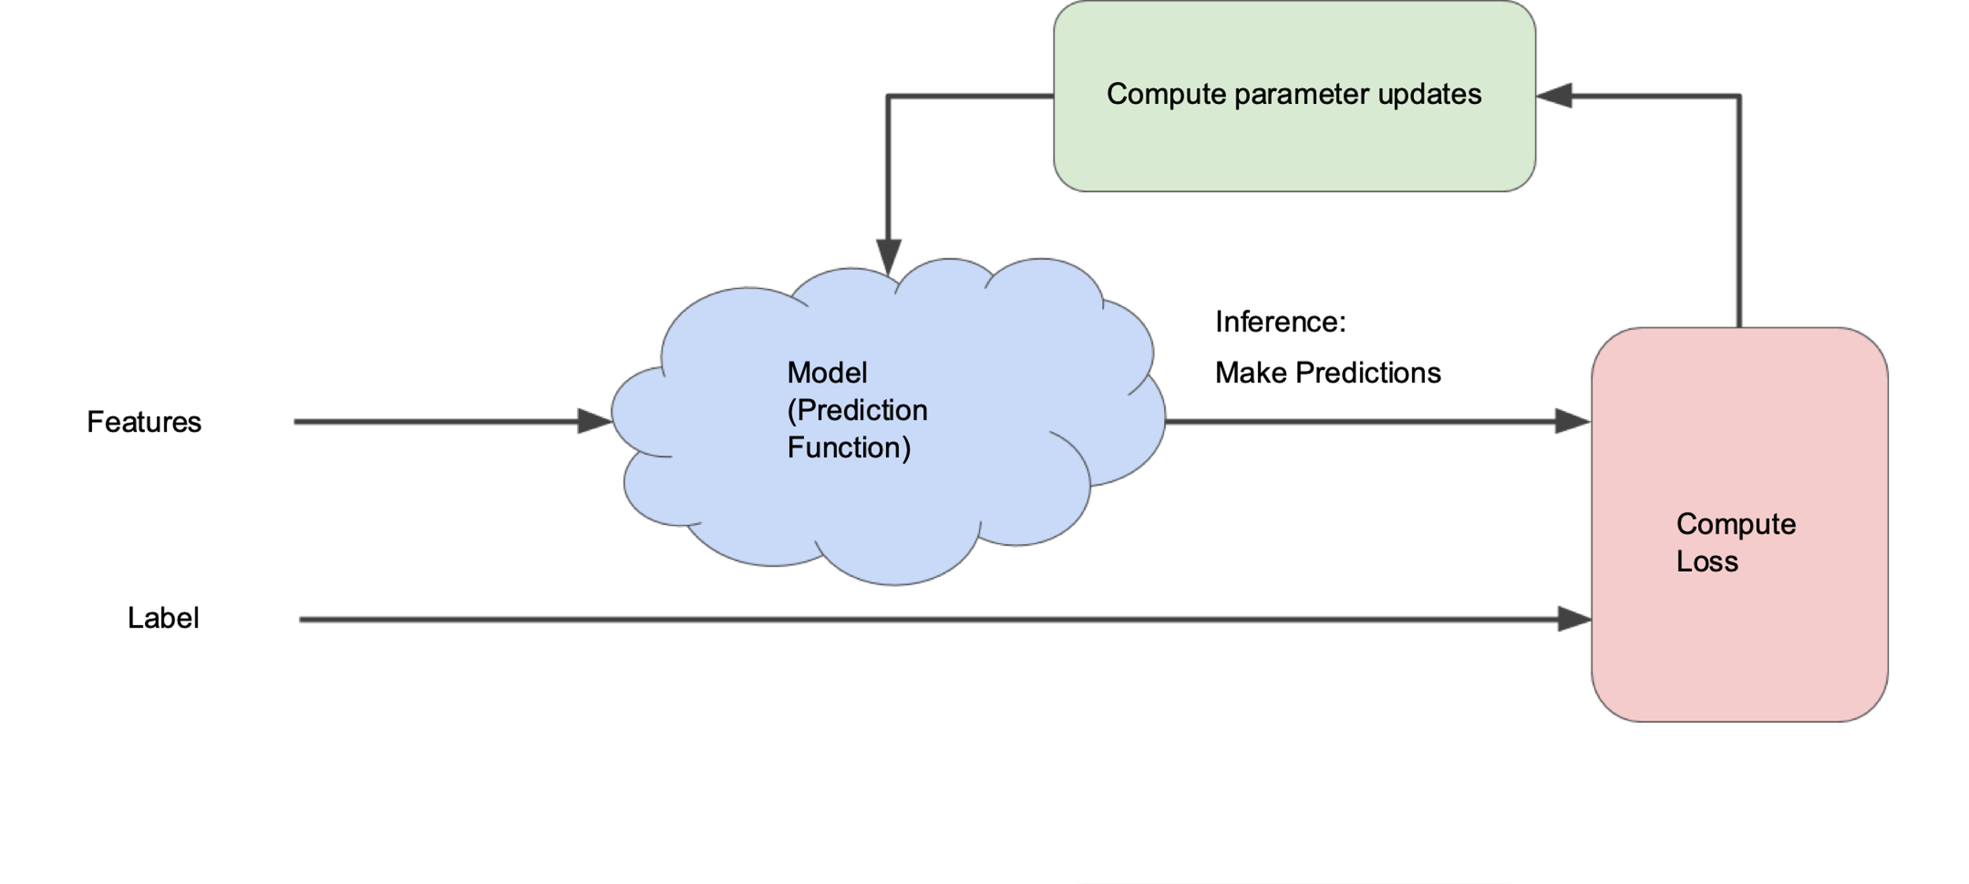
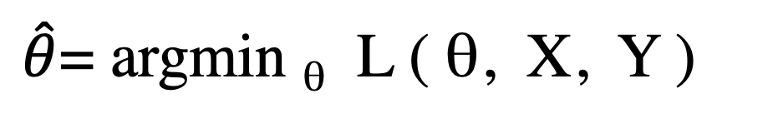
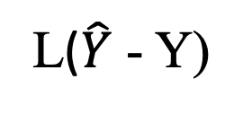

Fairy dust picture of optimization
$\hat{θ}$= argmin _{θ} L ( θ, X, Y )
Loss
Optimizer
parameters θ
$$\hat{Y}$$
X
Model
Loss
func.
features
predictions
Y
L($\hat{Y}$ - Y)
labels

Slide 45


Slide 46
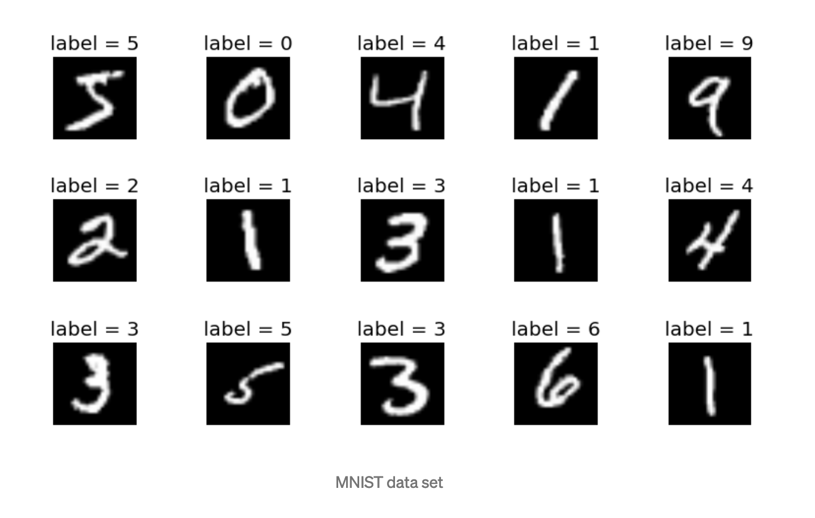
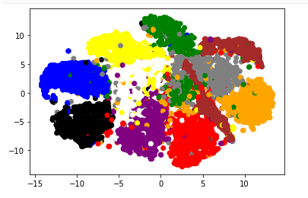
The Plan
Parameter estimation
Linear classifiers
Nonparametric methods, clustering
Optimization
Evaluation, choosing algorithm
Overfitting and regularization
Neural networks
Intro Deep Learning
I will shoot for half math, half hacking,
mostly with sklearn

Slide 47
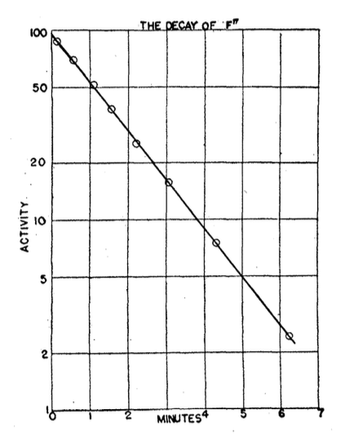
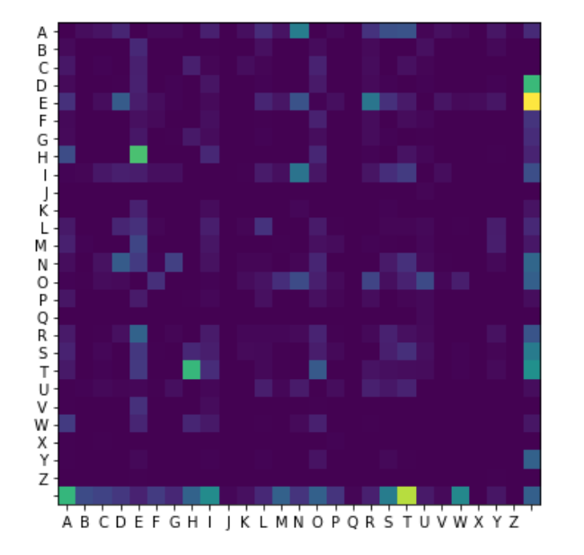
HW1

